Slide 1
JUnit

Slide 2
Version Control and Revision History
 | Name | Date
Prepared By | Sneha Kumar | 07-Mar-2019
Reviewed By | Manisha Mane | 07-Mar-2019
Approved By | Nisha Mendonsa | 07-Mar-2019
Version No. | Date | Section Affected | Highlight of Changes
1.0.0 | 07-Mar-2019 | All | Original Version.

Slide 3










Iconic Representations.......
Coffee Break
Can you Solve?
FAQ
Test your Memory
Objective
Queries
Demo
Recap
Need more Info
Brainstorm

Slide 4
Objectives
To Understand:
JUnit Overview
JUnit Test Framework
JUnit API
Test Cases
Asserts
Annotations
Test Suite
Parameterized Tests
Exception Tests
Mock Objects
Code Coverage

Slide 5
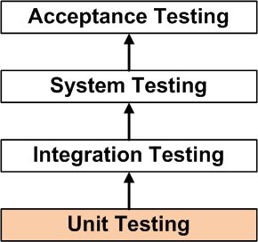
JUnit
What is JUnit?
An open source unit testing framework in Java
Released under IBM’s CPL and hosted on SourceForge
Originally written by Erich Gamma and Kent Beck
Important in the development of test-driven development
One of a family of unit testing frameworks collectively known as xUnit that originated with JUnit
Current version 4.x, however JUnit 3.8 is still widely used
JUnit 4 requires Java 1.5 at least, because it depends on Java “Annotations”.

Slide 6
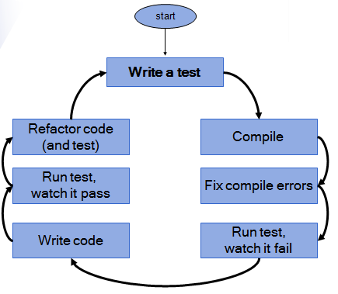
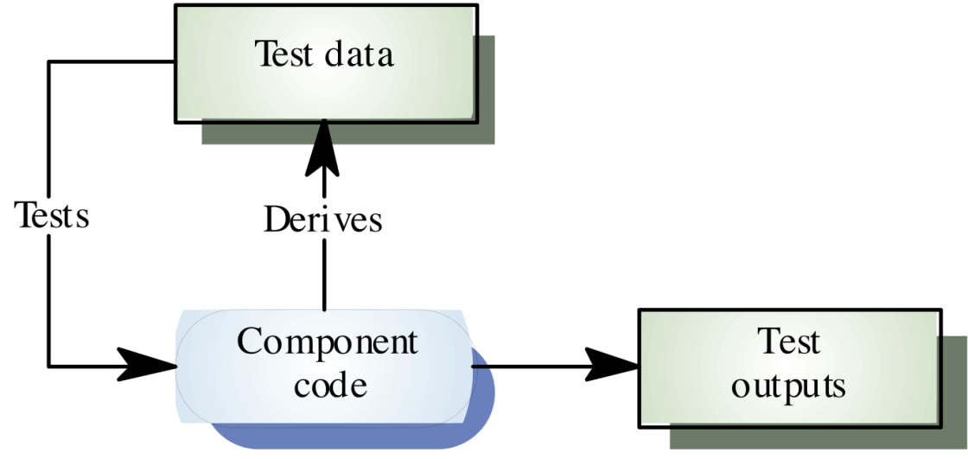
JUnit
What is TDD?
Test-driven development
The concept of test driven can simply be put as:.
“The first step is to quickly add a test, basically just enough code to fail
Run your tests, often the complete test suite to ensure that the new test fails
Update functional code to make it pass the new tests
Run tests again. If they fail, update functional code and retest
Once the tests pass, the next step is to start over

Slide 7
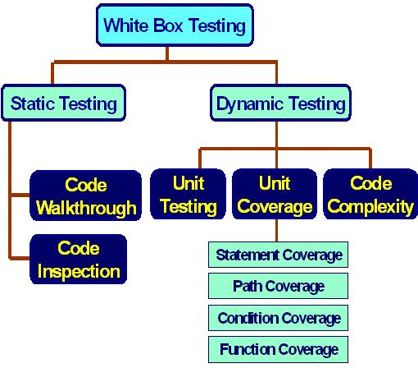
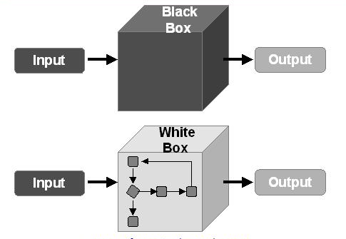
JUnit
Testing
Software testing is split up as white box testing and black box testing
Black box testing : The internal structure of the test subject is unknown, only information on relevant inputs and output is required
White box testing : Takes an internal perspective of the application and designs tests based on the internal structure, the code
JUnit is a type of white box testing.

Slide 8
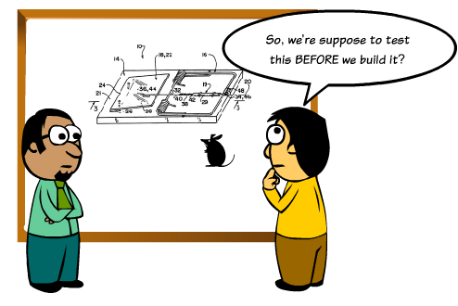
JUnit
Why JUnit?
Write better quality code faster
Run automatically, check results and provide immediate feedback rather than manually comb through a report of test results
Allows to organize tests into test suites containing test cases and even other test suites.
Is inexpensive
Other Test Framework
TestNG

Slide 9
JUnit
JUnit Framework

Slide 10
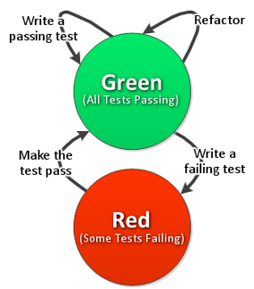
JUnit
JUnit Versions:
JUnit 3.x
Uses junit.framework.* packages
A test class:
extend the TestCase class which in turn extended the Assert class and made the assertion methods available
Method names must begin with "test"
Asserts are reported as failures
JUnit 4.x
Uses an org.junit.* package
TestCase:
Does not extend TestCase so you must specifically import the asserts
Any method annotated with "@Test" is a test method
No distinction between failures and errors. A test either passes, fails, or is ignored

Slide 11
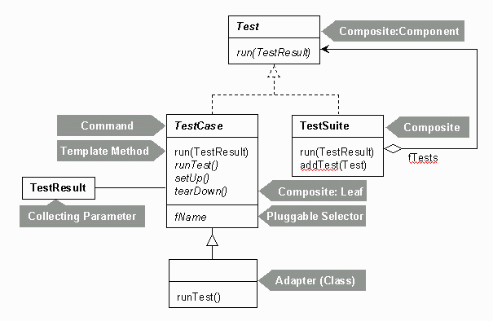
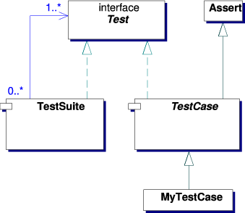
JUnit
JUnit Framework:
Test Case
User-written test basically extends the class Test Case
Test Suite
Multiple JUnit tests can be bundled together in a Test Suite
Assertions

Slide 12
JUnit
JUnit Framework:
Test Case:
test cases are Java code
test case = “sequence of operations +inputs + expected values”
JUnit 3.x
Class extends TestCase Class
TestCase is a part of junit.framework.* package
Contains one or more Tests/TestPlans represented by testXXX methods
Test methods must be public, [return void], and require no arguments
import junit.framework.TestCase;
public class ArithmeticTest extends TestCase {
public void testAddition() {
assertEquals(2, 1 + 1); // inherited from TestCase
}
}

Slide 13

JUnit
JUnit Framework:
JUnit 4.x
Instead of using a naming convention to identify a test method, in JUnit 4, any method annotated with "@Test" is a test method.
@Test is a part of org.junit.* package
Methods must be public, return void, and require no arguments
Test Method does not have to prefixed with 'test' (as in JUnit 3)
import org.junit.Test; // for @Test
import static org.junit.Assert.*; // assertEquals()
public class ArithmeticTest {
@Test
public void addition() {
assertEquals(2, 1 + 1);
}
}

Slide 14

JUnit
JUnit Framework:
Fixtures
It is a fixed state of a set of objects used as a baseline for running tests
Purpose is to ensure that there is a well known and fixed environment in which tests are run so that results are repeatable
Is useful if you have two or more tests for a common set of objects. Using a test fixture avoids duplicating the test code necessary to initialize and cleanup those common objects for each test
JUnit Framework automatically invokes the methods before/after each test
JUnit 3.x
Includes methods like:
setUp() : method which runs before every test invocation
tearDown() :method which runs after every test method

Slide 15
JUnit
JUnit Framework:
JUnit 3.x
Example
An important implication is, if you code any setUp or tearDown method in a TestCase class, you should only put test methods into this class which need your setUp/tearDown methods to run before/after it.
If you have a method which doesn't need these prep/cleanup actions, then move them into a TestCase that doesn't implement setUp/tearDown.
import org.junit.Test; // for @Test
import static org.junit.Assert.*; // assertEquals()
public class ArithmeticTest {
protected void setUp() { ………………. } protected void tearDown() { ……………….. } }

Slide 16
JUnit
JUnit Framework:
JUnit 4.x
No need to give setup & teardown names for methods implementing fixture
The fixtures are initialized within a method using the @Before (org.junit.Before) annotation
The @After(org.junit.After) will release any permanent resources allotted in the setUp method
@Before
public void setUp() {
……………………………….
}
@After
public void destroy() {
……………………………….
}

Slide 17
JUnit
JUnit Framework
Assert:
They are public methods defined in the base class TestCase
If the condition is false:
test fails
execution skips the rest of the test method
the message (if any) is printed
If the condition is true:
execution continues normally

Slide 18
JUnit
JUnit Framework
Assert:
Assert | Description
assertEquals(Type var1, Type var2) | Asserts that the two objects var1 and var2 (both of type Type) are equal.
assertFalse(boolean condition) | Asserts that a condition is false.
assertNotNull(Object object) | Asserts that an object isn't null.
assertNotSame(Object expected, Object actual) | Asserts that two objects refer to the different object.
assertNull(Object object) | Asserts that an object is null.
assertSame(Object expected, Object actual) | Asserts that two objects refer to the same object.
assertTrue(boolean condition) | Asserts that a condition is true.
fail(String message) | Fails a test with the given message.

Slide 19
JUnit
JUnit Framework
Annotations:
Annotation | Description
@Test public void method() | identifies that a method is a test method.
@Before public void method() | method is executed before each test. This method can prepare the test environment (e.g. read input data, initialize the class).
@After public void method() | Method is executed after each test. This method can cleanup the test environment (e.g. delete temporary data, restore defaults). It can also save memory by cleaning up expensive memory structures.
@BeforeClass public static void method() | This method is executed once, before the start of all tests. This can be used to perform time intensive activities, for example to connect to a database. Methods annotated with this annotation need to be defined as static to work with JUnit.
@AfterClass public static void method() | This method is executed once, after all tests have been finished. This can be used to perform clean-up activities, for example to disconnect from a database. Methods annotated with this annotation need to be defined as static to work with JUnit.

Slide 20
JUnit
JUnit Framework
JUnit 4.x Annotations:
Annotation | Description
@Ignore | Ignores the test method. This is useful when the underlying code has been changed and the test case has not yet been adapted. Or if the execution time of this test is too long to be included.
@Test (expected = Exception.class) | Fails, if the method does not throw the named exception.
@Test(timeout=100) | Fails, if the method takes longer than 100 milliseconds.
Annotation | Description
@Test public void method() | The annotation @Test identifies that a method is a test method.

Slide 21

JUnit
Junit Framework
Using @Ignore
Method annotated with @Ignore and doesn't run during test
Used to ignore or skip these cases but keep no-changes to existing code base
Example 1: Annotate Ignored for a test class, the Junit engine will bypass all test cases within this class
@Ignore("not today")
public class PersonTest extends Assert {
@Test
public void getName() {
assertEquals(person.getName(), “XYZ");
}
@Test
public void getAge() {
assertEquals(person.getAge(), 6);
}
}

Slide 22

JUnit
Junit Framework
Using @Ignore
Example 2: Annotate “Ignored” for test method, the Junit engine will only bypass current test method
public class PersonTest extends Assert {
@Ignore("not today")
@Test
public void getName() {
assertEquals(person.getName(), “XYZ");
}
public void getAge() {
assertEquals(person.getAge(), 6);
}
}

Slide 23

JUnit
Junit Framework
Using @Test(timeout=xx)
timeout values are specified in millisecond
JUnit4 timeout test case will help if it doesn't complete before timeout period
Example
If an unit test takes longer than the specified number of milliseconds to run, the test will be terminated and marked as failed
Extremely useful case to test the time-consuming operations
@Test(timeout = 1000L)
public void searchPersonByName(){
Person person = dao.search(“Abc");
assertEquals(person.getName(), “Abc");
}

Slide 24
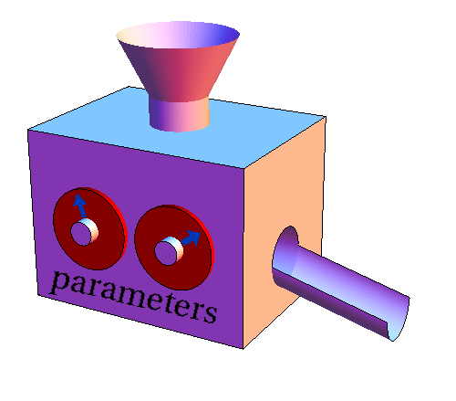
JUnit
JUnit Framework
Parameterized Tests
Parameterized tests is one of the features that have come along in the JUnit 4.x releases
Class can contain one test method executed with the different parameters
Not supported in Junit 3.x
Defining the Parameterized Test
Use the @RunWith(Parameterized.class) annotation to mark a class for parameterized tests
Create a public static method annotated with @Parameters that returns a Collection of Objects that make up your test data set.
Create a public constructor that takes in what is equivalent to one “row” of your test data.Create an instance variable for each “column” of test data.
Create your tests case(s) as you normally would using the instance variables as the source of the test data. The test case will be invoked once per each row of data.

Slide 25
JUnit
Parameterized Tests
Example:
Step 1: Using @RunWith
Step 2: @Parameters. A static method that generates and returns test data
@RunWith(Parameterized.class)
class FooTest {
@Parameters
public static Collection<Object[]> configs() {
Map<String, String> map1 = new HashMap<String, String>();
map1.put("Name", "Biall");
map1.put("Favourite Color", "Blue");
Map<String, String> map2 = new HashMap<String, String>();
map2.put("Name", "Sam");
map2.put("Favourite Color", "Plaid");
return Arrays.asList(new Object[][] {{ map1 },
{ map2 }
});

Slide 26
JUnit
Parameterized Tests
Example:
Step 3: A single constructor that stores the test data
Note: JUnit will actually execute an instance of the test for each row in your test data.
public FooTest(Map<String, String> map) {
this.map = map;
}
//... }

Slide 27

JUnit
Testing private methods
One of the ways to test a private method is using reflection
Use setAccessible(true) which allows the private method to be called outside the class
Example:
Method to test it:
public class MyClass {
private String myMethod(String s) { return s; } }
MyClass myClass = new MyClass();
Method method = MyClass.class.getDeclaredMethod("myMethod", String.class); method.setAccessible(true);
String output = (String) method.invoke(myClass, "some input");

Slide 28
JUnit
Suppose that as a part of the testing policy certain tests cases have to be run whenever a new feature is introduced. How can we achieve this?
Should we write individual classes for this?
Answer: We can make a suite of testcases with JUnit known as Test Suite

Slide 29

JUnit
JUnit Framework
Test Suite
TestSuite is composed of several TestCases or other TestSuite objects
Allows you to group multiple test cases into a collection and run them together
Junit 3.x
TestSuite is a container class, junit.framework.TestSuite, used in JUnit 3.8
import junit.framework.TestSuite;
public class JUnitTestSuite {
public static Test suite() {
TestSuite suite = new TestSuite(); suite.addTestSuite(TestsForOneClass.class); suite.addTestSuite(TestsForAnotherClass.class); return suite;
}
}

Slide 30
JUnit
Test Suite
Junit 4.x
Annotations @RunWith and @SuiteClasses are used to create test suites
The org.junit.runner.RunWith annotation takes a default value of a Runner class which will be used to run the tests rather than the default JUnit 4 Runner.
The org.junit.runners.Suite class is a runner that permits the tester to specify the classes containing tests to be run.
@BeforeClass and @AfterClass annotations comprises activities that really only need to be done once before all the tests are run and once after they complete
import org.junit.runner.RunWith;
import org.junit.runners.Suite;
import org.junit.runners.Suite.SuiteClasses;
@RunWith(Suite.class)
@SuiteClasses(
{ TestFeatureOne.class, TestFeatureTwo.class }
)
public class TestFeatureSuite { }

Slide 31
JUnit
Exception Testing

Slide 32
JUnit
Exception Tests
Exceptions can be tested in JUnit in many different ways:
Using a try-catch Block(Traditional Way)
Using the expected attribute of @Test Annotation
Using @Rule

Slide 33
JUnit
Exception Tests
Using a try-catch Block(Traditional Way)
The ‘traditional’ approach which was used with JUnit 3.x, before the introduction of annotations and rules
code is surrounded by a try-catch clause and tested for the exception thrown
package syntel.com;
import org.junit.*;
public class TryCatchException {
@Test
public void testException() {
try {
new Person('Joe', -1);
fail('Should have thrown an IllegalArgumentException because age is invalid!');
}catch (IllegalArgumentException e) { assertTrue(e.getMessage().contains('Invalid age'));
}
}
}

Slide 34
JUnit
Exception Tests
Using @Test Annotation
We can specify the type of exception should be thrown by the code to test
Results in cleaner code
Problem:
We can’t check if the message of the expected exception is correct
We can’t specify the line of code that is supposed to throw an exception
import static org.junit.Assert.*;
import org.junit.Test;
public class testAnnotation {
@Test(expected = IllegalArgumentException.class)
public void testException() {
new Person("Joe", -1);
}
}

Slide 35
JUnit
Exception Tests
Using JUnit's ExpectedException and @Rule annotation
JUnit 4.7 introduced rules, which are another extension mechanism for JUnit
ExpectedException helps to specify what exception is expected and even the exception message
package syntel.com;
import org.junit.*;
public class ExpectedException {
@Rule
public ExpectedException exception = ExpectedException.none();
@Test
public void testExpectedException() { exception.expect(IllegalArgumentException.class); exception.expectMessage(containsString('Invalid age')); new Person('Joe', -1); }
}
}

Slide 36
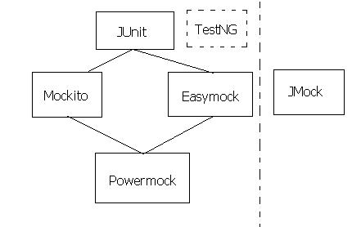
JUnit
Mock Objects
Are perfectly suited for testing a portion of code logic in isolation
They are similar to stubs
Configured to simulate the object that it replaces
Also verifies whether it is used as expected
EasyMock has been the first dynamic Mock Object generator
Popular Mock Frameworks:
jMock
EasyMock
Mockito

Slide 37
Queries

Slide 38
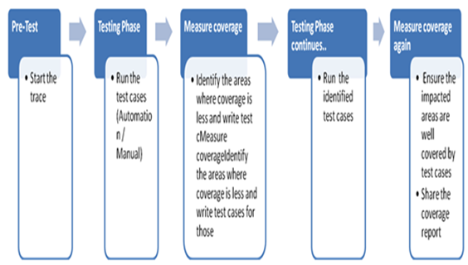
JUnit
Code Coverage:
Is a measure of Test effectiveness
It involves designing and executing test cases and finding out the percentage of code that is covered by testing
It is an activity in the White Box Testing to validate the following:
All the statements in the code are executed atleast once
All the Decision statements are executed and covered
All the conditions are tested
Optional aspect of code coverage analysis is:
Identifying redundant test cases that do not increase coverage.

Slide 39
JUnit
Code Coverage:
Open Source Code Coverage Tools:
EMMA
Clover
Allows testing time to be reduced by only running the tests that cover the application code that was modified since the previous build
JACoCo
JaCoCo offers line and branch coverage
CodeCover
Supports statement coverage, branch coverage, loop coverage and strict condition coverage

Slide 40

JUnit
PMD:
Tool for checking Java Source Code
abbreviated as Programming Mistake Detector
PMD errors are not true errors, but rather inefficient code
The application could still function properly even if they were
not corrected
Is a static ruleset based Java source code analyzer that identifies potential problems like:
Possible bugs : Empty try/catch/finally/switch blocks
Dead code : Unused local variables, parameters and private methods
Empty if/while statements
Overcomplicated expressions : Unnecessary if statements, for loops that could be while loops
Suboptimal code : Wasteful String/StringBuffer usage
Classes with high Cyclomatic Complexity measurements
Duplicate code : Copied/pasted code can mean copied/pasted bugs, and decreases maintainability

Slide 41
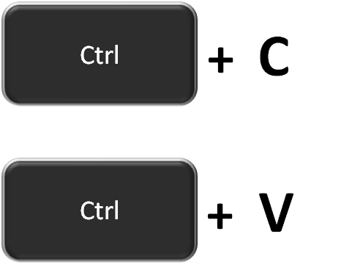
JUnit
PMD:
PMD includes a set of built-in rules and supports the ability to write custom rules
CPD:
Copy Paste Detector
Add-on to PMD that finds duplicated code
Uses a variation of the Karp-Rabin string matching algorithm
It is also successful in returning similar code across different files and can be used as a tool for detecting similarity in source-code files

Slide 42
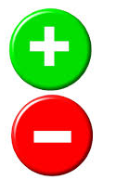
JUnit
Advantages of Testing with JUnit
Quick and easy generation of test cases and test data.
Ability to reuse the older test cases as well as the test data for making a new test case.
Generate test cases which stick on to their previous test values
Promote TDD, i.e. Test Driven Development
Enhance productivity and reduce production cost
Excellent and highly comprehensive reporting technique
Easy contrast between expected output and the output displayed on the console.

Slide 43
JUnit
Can we test a private method in JUnit?
Answer: No, Private methods cannot be directly tested directly. It can be indirectly tested by testing the method it supports.

Slide 44
JUnit
Why Not Just Write a main() Method for Unit Testing?
Answer: This is not a recommended approach because of the following points:
Your classes will be cluttered with test code in main method. All those test codes will be packaged into the final product.
If you have a lots of classes to test, you need to run the main() method of every class. This requires some extra coding effort.
If you want the test results to be displayed in a GUI, you will have to write code for that GUI.
If you want to log the results of tests in HTML format or text format, you will have to write additional code.
If one method call fails, next method calls won?t be executed. You will have to work-around this.
The above problems will be taken care of automatically if you use JUnit.

Slide 45
Brainstorm

Slide 46
Recap
We have learnt about :
JUnit:
JUnit has a strong standing in terms of unit testing software in the java world
Based on a collection of Unit Testing frameworks called xUnit
Supports using assertions for testing expected results
JUnit 4.x, parameterized tests allow you to run the same test over and over again using different values
From JUnit 3.x to 4.x
JUnit 4 requires Java 5 or newer
Don’t extend junit.framework.TestCase; just use an ordinary class
Import org.junit.* and org.junit.Assert.*
Use a static import for org.junit.Assert.*
Static imports replace inheritance from junit.framework.TestCase
Use annotations instead of special method names:
Instead of a setUp method, put @Before before some method
Instead of a tearDown method, put @After before some method
Instead of beginning test method names with ‘test’, put @Test before each test method

Slide 47
References
Website
http://en.wikipedia.org/wiki/Unit_testing
http://www.junit.org/
http://junit.sourceforge.net/doc/cookstour/cookstour.htm
http://pub.admc.com/howtos/junit4x/junit4x.html
Books
JUnit in Action (Second Edition)
Manning

Slide 48
Thank You.

